Slide 1


Exploratory Data Analysis
Exploratory Data Analysis Mini Project
By Piyali Dey

Slide 2
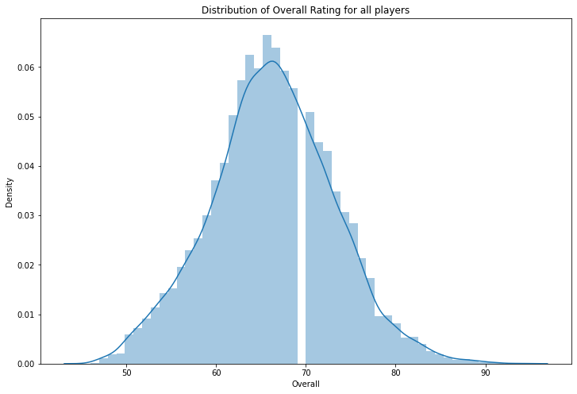
Analyse The Distribution Plot
After Cleaning the data ‘Fifa.csv’ file use distribution plot to analyse the Overall Rating for all the Players.
According to the graph we can say that the graph is symmetry

Slide 3

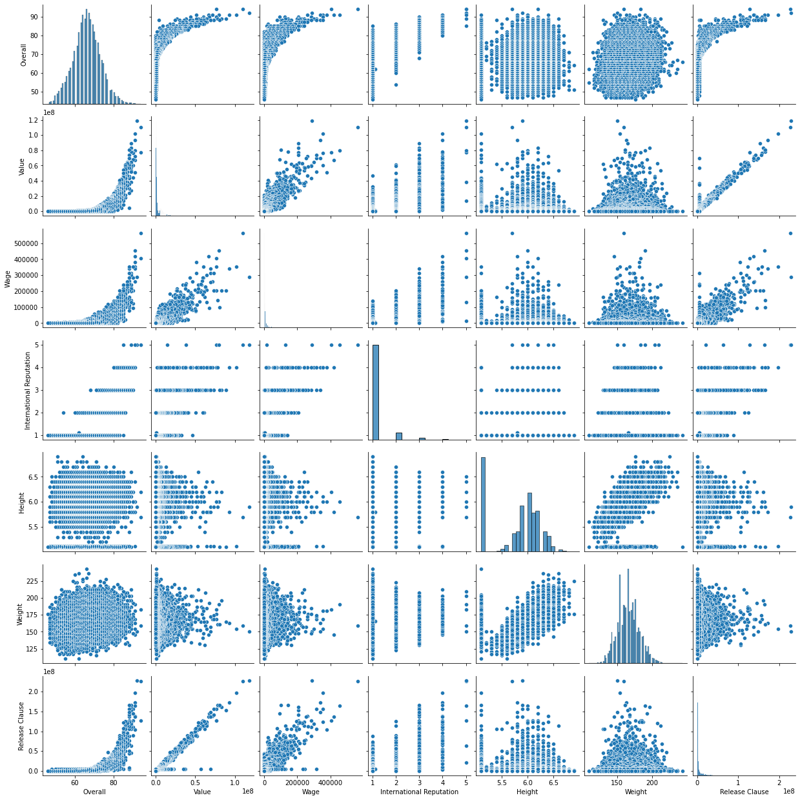
Analysing The Pair Plot
Pair plot is a plot where we can easily find several Distribution plot and all types of scatter plot .
In this case we can see the relation ships and the distribution for all these columns below:
Overall, Value, Wage, International Reputation, Height, Weight, Release Clause

Slide 4
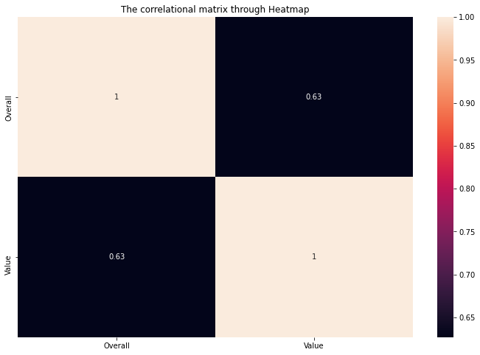
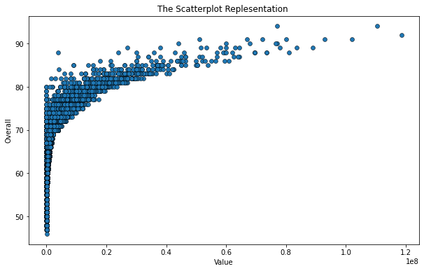
Overall Ratings and Values are strongly correlated with each other. Overall Rating Increased value increased for all the players

Slide 5
FINAL STEP
After all the Data Prepossessing ,Data cleaning we did the Graphical Representation.
Generated a table ‘top20.xlsx’ with top 20 players whose contract expire in 2020
Also generate a table ‘combined table’ with top 5 players for each Position.

